Slide 1
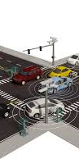

Traffic Manager
Supervisor
Dr. Amira A. Alshazly

Slide 2
Traffic Manager
Team Members
Ahmed Ibrahim Hassan
Bichay Adel Ramses
Emad Mohammed Fawzy
Kerolss Bolis Shehata
Marwa Shebl Mohammed
Mayan Islam Mohammed
Mostafa Hussian Mostafa
Remon Ehab Ramses
Taha Fawzy Elshrif
Youssef Ibrahim Hanfy
Supervisor
Dr. Amira A. Alshazly

Slide 3
Objectives
1- Quick overview of the problem.
2- Explore Scientific Background.
3- Comparison of related papers and systems.
4- Overview of the need to extend current solutions.
5- Overview of tools and system design. 6- Overview of development and implementation. 7- Experimental design and results. 8- Demonstration of the implemented prototype. 9- Conclusion and future directions.

Slide 4
Agenda
Background of the problem
Scientific Background
Comparison between related papers
Comparison between similar systems
Possible extensions to current solutions
Scope of work
Project plan
Tools and environment
Overview of environment and data
Experiments design
Result of experiments
Mobile implementation
Prototype implementation
Conclusion
Future work

Slide 5
Objectives
1- Quick overview of the problem.
2- Explore Scientific Background.
3- Comparison of related papers and systems.
4- Overview of the need to extend current solutions.
5- Overview of tools and system design. 6- Overview of development and implementation. 7- Experimental design and results.
8- Demonstration of the implemented prototype. 9- Conclusion and future directions.

Slide 6
Agenda
Background of the problem
Scientific Background
Comparison between related papers
Comparison between similar systems
Possible extensions to current solutions
Scope of work
Project plan
Tools and environment
Overview of environment and data
Experiments design
Result of experiments
Mobile implementation
Prototype implementation
Conclusion
Future work

Slide 7
1. Background of the problem
1.1. Background
1.2. Project Idea

Slide 8
1. Background of the problem
1.1. Background
1.2. Project Idea

Slide 9
1.1. Background
Rising Vehicle Numbers 📈: Increasing vehicles cause severe traffic congestion [1, 2024] and disrupts work and daily life in Egyptian cities [2, 2022].
Environmental & Health Toll 🌍😷: Congestion harms the environment, public health, and productivity [1, 2024].
Infrastructure Investment 🛣️: Egypt is spending in road infrastructure development[3, 2024].
Need for Dynamic Solutions ⏱️: Real-time, adaptive responses are critical for effective traffic management [1, 2024].

Slide 10
1. Background of the problem
1.1. Background
1.2. Project Idea

Slide 11
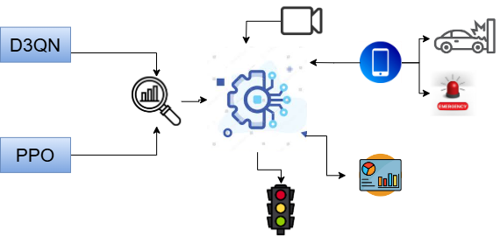
1.2. Project Idea
Project Goal 🎯: Optimizes traffic signals by adapting to real-time road conditions, trained on Egypt’s roads.

Slide 12
Objectives
1- Quick overview of the problem.
2- Explore Scientific Background.
3- Comparison of related papers and systems.
4- Overview of the need to extend current solutions.
5- Overview of tools and system design. 6- Overview of development and implementation. 7- Experimental design and results. 8- Demonstration of the implemented prototype. 9- Conclusion and future directions.

Slide 13
Agenda
Background of the problem
Scientific Background
Comparison between related papers
Comparison between similar systems
Possible extensions to current solutions
Scope of work
Project plan
Tools and environment
Overview of environment and data
Experiments design
Result of experiments
Mobile implementation
Prototype implementation
Conclusion
Future work

Slide 14
2. Scientific Background
2.1. Simulation
2.2. Proximal Policy Optimization (PPO)
2.3. Dueling Double Deep Q network (D3QN)
2.4. You Only Look Once (YOLO)

Slide 15
2. Scientific Background
2.1. Simulation
2.2. Proximal Policy Optimization (PPO)
2.3. Dueling Double Deep Q network (D3QN)
2.4. You Only Look Once (YOLO)

Slide 16
2.1. Simulation [4]
A simulation represents how a system works, helping in decision-making by testing various scenarios.
Applications: Used in performance enhancement, process optimization, safety assurance, theoretical testing, training, and entertainment.
Benefits:
Safe and cost-effective for inaccessible or conceptual systems.
Provides insights without real-world risks.

Slide 17
2.1. Simulation [5] (Cont.)
Simulating systems involves various frameworks tailored to specific applications. In the field of traffic optimization, some popular frameworks include:
SUMO: An open-source traffic simulation framework widely used in research and related work. Its free availability makes it a suitable choice for our project, and we will provide an explanation of its application.
PTV Vissim: A commercial traffic simulation framework that offers advanced features such as 3D visualization, pedestrian simulation, and seamless integration with other PTV software.
Additionally, Gym is commonly used in reinforcement learning due to its ease of integration and user-friendly environment, making it ideal for training AI models in traffic-related applications.

Slide 18
2. Scientific Background
2.1. Simulation
2.2. Proximal Policy Optimization (PPO)
2.3. Dueling Double Deep Q network (D3QN)
2.4. You Only Look Once (YOLO)

Slide 19
2.2. Proximal Policy Optimization (PPO) [6] , [7,2019]
🧠 Reinforcement Learning: Two Main Approaches
✅ Policy-Based Methods
Learn directly how to act in each state.
Two types:
Deterministic: Always picks the same action for a state.
Stochastic: Picks actions randomly based on probabilities.
📊 Value-Based Methods
Learn how good it is to be in a state or take an action.
Two key functions:
V(s): How good is a state?
Q(s, a): How good is an action in a state?

Slide 20
2.2. Proximal Policy Optimization (PPO) [6] , [7,2019]
PPO stands for Proximal Policy Optimization.
It is a reinforcement learning algorithm used to train agents to make decisions.
A hybrid method that improves policy-based learning using feedback from value estimates for stable training.
PPO improves an older method called A2C (Advantage Actor-Critic) by making learning more stable and reliable.
It helps agents learn better actions while avoiding big, risky changes in behavior.

Slide 21

2.2. Proximal Policy Optimization (PPO) [6] , [7,2019]
How Does PPO Work?
After the agent takes actions, PPO compares the new behavior with the old one.
It calculates a ratio that shows how much the new policy changed.
If the change is too big, PPO clips (limits) it — keeping the change small and safe.
This prevents the agent from forgetting what it learned too quickly.

Slide 22
2.2. Proximal Policy Optimization (PPO) [6] , [7,2019]
Why Use PPO for Traffic Optimization?
PPO is a modern algorithm that works well in many challenging environments.
It learns stable and efficient control policies, which is great for managing dynamic traffic conditions.
It avoids sudden or bad decisions by using safe, gradual updates.
PPO has shown high performance in simulation tasks — making it a strong choice for:
Traffic signal control
Vehicle flow optimization
Reducing congestion

Slide 23
2. Scientific Background
2.1. Simulation
2.2. Proximal Policy Optimization (PPO)
2.3. Dueling Double Deep Q network (D3QN)
2.4. You Only Look Once (YOLO)

Slide 24
2.3.D3QN [8, 2022],[9, 2024]
🧮 Q-Learning (QN)
Learns a Q-table: maps (state, action) → expected reward.
Works well in small environments.
Struggles with large or complex state spaces.
🤖 Deep Q-Network (DQN)
Replaces the Q-table with a neural network.
Input: state → Output: Q-values for each action.
Can handle high-dimensional states like images (e.g., games).
🧠 Problem with DQN: Tends to overestimate Q-values, which can lead to unstable learning.

Slide 25
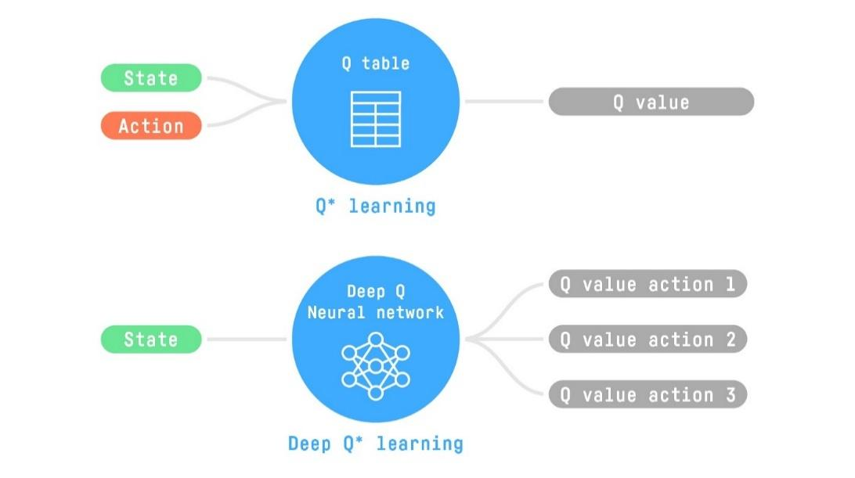
2.3.D3QN [8, 2022], [9, 2024] (Cont.)

Slide 26
2.3.D3QN [8, 2022], [9, 2024] (Cont.)
🔧 Double DQN (DDQN)
Fixes DQN's overestimation issue.
Uses two networks:
One for selecting the best action.
One for evaluating its value.
📉 This makes learning more accurate and stable.
🟢 DDQN = More reliable decisions, especially in complex environments.

Slide 27
2.3.D3QN [8, 2022], [9, 2024] (Cont.)
Double Dueling Deep Q-Network (D3QN)
D3QN combines:
Double Q-Learning (Double DQN): The explained D2QN that reduces overestimation bias in Q-value estimates.
Dueling Network Architecture: Divides the network into two streams to separately estimate the state-value function and the advantage function for each action enabling to calculate more efficiently
Advantage function: This tells you how much better a specific action is compared to others in that state.

Slide 28
2.3.D3QN [8, 2022], [9, 2024] (Cont.)
✅ Stable Learning
D3QN avoids overestimation, making training more stable.
Stable policies are crucial for managing unpredictable traffic patterns.
📈 Impact on Our Project
Helps the system make reliable decisions under varying traffic conditions.
Leads to better control and faster adaptation, especially when roads or flow patterns change.

Slide 29
2. Scientific Background
2.1. Simulation
2.2. Proximal Policy Optimization (PPO)
2.3. Dueling Double Deep Q network (D3QN)
2.4. You Only Look Once (YOLO)

Slide 30
2.4. Computer Vision (YOLO) [10][11]
YOLOv11 is a fast and accurate object detection model (Ultralytics version).
Divides the image into a grid and assigns detection tasks to grid cells.
Runs detection in real-time using a convolutional neural network (CNN).

Slide 31
2.4. Computer Vision (YOLO) [10][11] (Cont.)
Each cell predicts bounding boxes and confidence scores.
Uses Non-Maximum Suppression (NMS) to remove duplicate detections.

Slide 32
2.4. Computer Vision (YOLO) [10][11] (Cont.)
🏷️ Object Detection
Task of locating and identifying objects in images or videos.
Used in self-driving cars, surveillance, robotics, etc.
🚗 Speed Estimation
Objects are detected and tracked across video frames.
Movement is measured in pixels between frames.
Real-world scale and frame rate are used to calculate speed.
Speed is estimated and displayed for each tracked object.

Slide 33
Objectives
1- Quick overview of the problem.
2- Explore Scientific Background.
3- Comparison of related papers and systems.
4- Overview of the need to extend current solutions.
5- Overview of tools and system design. 6- Overview of development and implementation. 7- Experimental design and results. 8- Demonstration of the implemented prototype. 9- Conclusion and future directions.

Slide 34
Agenda
Background of the problem
Scientific Background
Comparison between related papers
Comparison between similar systems
Possible extensions to current solutions
Scope of work
Project plan
Tools and environment
Overview of environment and data
Experiments design
Result of experiments
Mobile implementation
Prototype implementation
Conclusion
Future work

Slide 35
3. Comparison between related papers
3.1. Environment
3.2. Characteristics of the dataset
3.3. Learning paradigm
3.4. Model
3.5. Characteristics of model
3.6. App
3.7. The used sensors

Slide 36
3. Comparison between related papers(Cont.)
 |  | [1,2024] | [8,2022] | [12,2024] | [13,2024] | [14,2024] | [7,2019] | [2,2022] | Ours
Year |  | 2024 | 2022 | 2024 | 2024 | 2024 | 2019 | 2023 | 2025
Journal Rank |  | Q1 | Q1 | conference | Q1 | Q2 | package | Graduation Report | Graduation Report
Survey |  | ✔ | ✔ | ✔ | ✔ | ✔ | ✔ | ✔ | ✔
Open source |  | No | No | Yes | No | No | Yes | Yes | Yes
Environment | GYM | ✘ | ✘ | ✘ | ✘ | ✘ | ✔ | ✘ | ✔
 | SUMO | ✔ | ✔ | ✘ | ✘ | ✔ | ✔ | ✔ | ✔
 | VISSIM | ✘ | ✘ | ✔ | ✔ | ✘ | ✘ | ✘ | ✘
Characteristics of dataset | Length of line | ✔ | ✘ | ✔ | ✘ | ✔ | ✘ | ✔ | ✔
 | Flow of traffic | ✔ | ✔ | ✔ | ✘ | ✔ | ✔ | ✔ | ✔
 | Weather | ✔ | ✘ | ✘ | ✘ | ✘ | ✘ | ✘ | ✘
 | Pedestrians | ✔ | ✔ | ✘ | ✘ | ✘ | ✘ | ✘ | ✘
 | Time of day | ✔ | ✔ | ✘ | ✘ | ✘ | ✘ | ✘ | ✘

Slide 37
3. Comparison between related papers(Cont.)
 |  | [1,2024] | [8,2022] | [12,2024] | [13,2024] | [14,2024] | [7,2019] | [2,2022] | Ours
Objective | Decrease delay | ✔ | ✔ | ✔ | ✔ | ✔ | ✔ | ✔ | ✔
 | Fairness | ✔ | ✔ | ✘ | ✘ | ✔ | ✔ | ✔ | ✔
 | Energy | ✔ | ✘ | ✘ | ✘ | ✘ | ✘ | ✘ | ✘
Learning Paradigms | Reinforcement learning | ✔ | ✔ | ✔ | ✘ | ✔ | ✔ | ✔ | ✔
 | supervised learning | ✘ | ✘ | ✘ | ✔ | ✘ | ✘ | ✘ | ✘

Slide 38
3. Comparison between related papers(Cont.)
 |  | [1,2024] | [8,2022] | [12,2024] | [13,2024] | [14,2024] | [7,2019] | [2,2022] | Ours
Model | ML | Heuristic | ✘ | ✘ | ✘ | ✔ | ✘ | ✘ | ✘ | ✘
 |  | Random forest | ✘ | ✘ | ✘ | ✔ | ✘ | ✘ | ✘ | ✘
 |  | Extreme Gradient Boosting | ✘ | ✘ | ✘ | ✔ | ✘ | ✘ | ✘ | ✘
 | DL | DNN | ✘ | ✘ | ✘ | ✔ | ✘ | ✘ | ✘ | ✘

Slide 39
3. Comparison between related papers(Cont.)
 |  |  | [1,2024] | [8,2022] | [12,2024] | [13,2024] | [14,2024] | [7,2019] | [2,2022] | Ours
Model | ML | Heuristic | ✘ | ✘ | ✘ | ✔ | ✘ | ✘ | ✘ | ✘
 | RL | A2C | ✘ | ✘ | ✔ | ✘ | ✘ | ✘ | ✘ | ✘
 |  | A3C | ✔ | ✘ | ✘ | ✘ | ✘ | ✘ | ✘ | ✘
 |  | HMAS | ✔ | ✘ | ✘ | ✘ | ✘ | ✘ | ✘ | ✘
 |  | DITLCS | ✔ | ✘ | ✘ | ✘ | ✘ | ✘ | ✘ | ✘
 |  | RACS-A2C | ✔ | ✘ | ✘ | ✘ | ✘ | ✘ | ✘ | ✘
 |  | MFDQL-DTC | ✔ | ✘ | ✘ | ✘ | ✘ | ✘ | ✘ | ✘
 |  | GSCTSA-A3C | ✔ | ✘ | ✘ | ✘ | ✘ | ✘ | ✘ | ✘
 |  | DQN | ✘ | ✘ | ✔ | ✘ | ✔ | ✔ | ✔ | ✔
 |  | DDQN | ✘ | ✘ | ✔ | ✘ | ✔ | ✔ | X | ✘
 |  | D3QN | ✘ | ✔ | ✔ | ✘ | X | X | X | ✔
 |  | PPO | ✘ | ✘ | X | ✘ | X | ✔ | X | ✔
Best Model |  |  | GSCTSA - A3C | D3QN | D3QN | XGBoost | DDQN | PPO | DQN | D3QN
 |  | [1, 2024] | [7, 2022] | [8, 2024] | [5, 2024] | [6, 2024] | [14, 2019] | [2, 2022]
Learning paradigm | Reinforcement learning | ✔ | ✔ | ✔ | ✘ | ✔ | ✔ | ✔
 | Supervised learning | ✘ | ✘ | ✘ | ✔ | ✘ | ✘ | ✘

Slide 40
3. Comparison between related papers(Cont.)
 |  | [1,2024] | [8,2022] | [12,2024] | [13,2024] | [14,2024] | [7,2019] | [2,2022] | Ours
Characteristics | Edge | ✔ | ✘ | ✘ | ✘ | ✘ | ✘ | ✘ | ✔
 | Feedback | ✘ | ✔ | ✘ | ✘ | ✘ | ✘ | ✘ | ✘
 | Handle accidents | ✔ | ✔ | ✘ | ✘ | ✘ | ✘ | ✘ | ✔
 | priority for emergency vehicle | ✘ | ✘ | ✘ | ✘ | ✘ | ✘ | ✘ | ✔
 | predict traffic | ✔ | ✘ | ✘ | ✘ | ✘ | ✘ | ✔ | ✘
 | Notify with certain news | ✘ | ✘ | ✘ | ✘ | ✘ | ✘ | ✘ | ✘
App | Mobile | ✘ | ✘ | ✘ | ✘ | ✘ | ✘ | ✘ | ✔
 | IoT | ✔ (theoretical) | ✘ | ✔ | ✘ | ✘ | ✘ | ✘ | ✔
Sensors | Camera | ✔ | ✔ | ✔ | ✘ | ✘ | ✘ | ✘ | ✔
 | Inductive loops | ✔ | ✘ | ✔ | ✘ | ✔ | ✘ | ✘ | ✘
 | Weather | ✔ (Rain-time of day) | ✘ | ✘ | ✘ | ✘ | ✘ | ✘ | ✘
 |  | [1, 2024] | [7, 2022] | [8, 2024] | [5, 2024] | [6, 2024] | [14, 2019] | [2, 2022]
Learning paradigm | Reinforcement learning | ✔ | ✔ | ✔ | ✘ | ✔ | ✔ | ✔
 | Supervised learning | ✘ | ✘ | ✘ | ✔ | ✘ | ✘ | ✘

Slide 41
Agenda
Background of the problem
Scientific Background
Comparison between related papers
Comparison between similar systems
Possible extensions to current solutions
Scope of work
Project plan
Tools and environment
Overview of environment and data
Experiments design
Result of experiments
Mobile implementation
Prototype implementation
Conclusion
Future work

Slide 42
4. Comparison between similar systems
 | [15] Intellias | [16] Telegra | [17] Iteris | [18] Kapsch | Ours
Cybersecurity | ✔ | ✘ | ✔ | ✔ | ✘
edge | ✔ | ✔ | ✔ | ✔ | ✔
Road safety (accidents) | ✔ | ✔ | ✔ | ✔ | ✔
tunnels | ✘ | ✔ | ✔ | ✘ | ✘
predict | ✔ | ✘ | ✔ | ✔ | ✘
Resilient to water | ✘ | ✔ | ✔ | ✔ | ✘
Identify and track traffic violators | ✘ | ✘ | ✘ | ✘ | ✘
Pedestrian monitoring | ✘ | ✘ | ✘ | ✘ | ✘

Slide 43
Objectives
1- Quick overview of the problem.
2- Explore Scientific Background.
3- Comparison of related papers and systems.
4- Overview of the need to extend current solutions.
5- Overview of tools and system design. 6- Overview of development and implementation. 7- Experimental design and results. 8- Demonstration of the implemented prototype. 9- Conclusion and future directions.

Slide 44
Agenda
Background of the problem
Scientific Background
Comparison between related papers
Comparison between similar systems
Possible extensions to current solutions
Scope of work
Project plan
Tools and environment
Overview of environment and data
Experiments design
Result of experiments
Mobile implementation
Prototype implementation
Conclusion
Future work

Slide 45
5. Possible extensions to current solutions
After a thorough review of the tables, we concluded that:
1. No implemented open-source system provides adequate documentation explaining the technologies or methods used.
2. Only one of the existing papers address the Egyptian context, and the latest project report [2, 2022] fails to document the entire case.
3. We need to train a traffic optimization model. Most related work relies on simulations because they are cost-effective and suitable for training purposes.

Slide 46
5. Possible extensions to current solutions
4. The system's simulation should include key factors such as line length and traffic flow, which are commonly considered in similar systems. Additionally, elements like pedestrian presence, weather conditions, and time of day should be incorporated to enhance the model's accuracy.
5. The primary focus of the system should be minimizing traffic delays and ensuring fairness among vehicles. In some cases, energy consumption can be directly considered as an optimization factor.

Slide 47
5. Possible extensions to current solutions
6. In the latest related work on traffic optimization, reinforcement learning (RL) is used, yielding better results compared to traditional machine learning (ML).
7. Recent research also attempts to consider state temporal and spatial information, consider nearby intersections (by using GAT, LSTM), and optimize the model as much as possible [1, 2024] , [19, 2023] , [20, 2024] , [21, 2021].
8. Baseline modeling should involve using an available online model as a baseline, followed by performance improvements through customizing rewards, enhancing the model, training multiple models, or applying techniques such as grid search or Optuna.

Slide 48
5. Possible extensions to current solutions
9. Deploying the system in real-world IoT environments is essential. Common traffic monitoring sensors, including cameras, inductive loops, and weather sensors, should be utilized when environmental conditions are considered.
10. The system should be designed to be interactive, allowing user feedback to be provided for continuous improvement. Additionally, relevant updates and alerts should be sent to users.
11. Continuous refinement should be conducted by leveraging real-world data collected after deployment, enabling the system to adapt to changes such as government road improvements or the deterioration of road conditions due to factors like rain.

Slide 49
5. Possible extensions to current solutions
12. Accidents must be handled effectively by ensuring road sections are halted when incidents occur to maintain safety [15] , [17] , [18].
13. Traffic prediction capabilities should be integrated so that congestion can be anticipated and traffic flow optimized accordingly [15] , [17] , [18].
14. Cybersecurity measures must be implemented to ensure system safety and compliance with cyber regulations [15] , [17] , [18].
15. Fast response times should be ensured for both users and traffic conditions, minimizing the impact of factors such as distance and internet latency [1, 2024]

Slide 50
5. Possible extensions to current solutions
16. Traffic violators should be identified and tracked to enforce regulations effectively [15] , [17] , [18].
17. Support for emergency vehicles must be provided, and awareness of accidents should be maintained to ensure quick and safe passage.

Slide 51
Agenda
Background of the problem
Scientific Background
Comparison between related papers
Comparison between similar systems
Possible extensions to current solutions
Scope of work
Project plan
Tools and environment
Overview of environment and data
Experiments design
Result of experiments
Mobile implementation
Prototype implementation
Conclusion
Future work

Slide 52
6. Scope of work
From slide 5. Possible extensions to current solutions
Make a documented open-source project.
Train on crowded area in Egypt.
Simulate using SUMO.
Include main road measurements such as traffic flow and speed in the simulation.
Minimize delays and ensure fairness.
Use reinforcement learning (PPO, D3QN).

Slide 53
6. Scope of work
Baseline modeling using open-source data from Egypt.
Develop a small prototype for a single intersection using video analysis with computer vision.
Latency should be optimized with a near real-time processing architecture.
A mobile application should be developed.

Slide 54
Objectives
1- Quick overview of the problem.
2- Explore Scientific Background.
3- Comparison of related papers and systems.
4- Overview of the need to extend current solutions.
5- Overview of tools and system design. 6- Overview of development and implementation. 7- Experimental design and results. 8- Demonstration of the implemented prototype. 9- Conclusion and future directions.

Slide 55
Agenda
Background of the problem
Scientific Background
Comparison between related papers
Comparison between similar systems
Possible extensions to current solutions
Scope of work
Project plan
Tools and environment
Overview of environment and data
Experiments design
Result of experiments
Mobile implementation
Prototype implementation
Conclusion
Future work

Slide 56
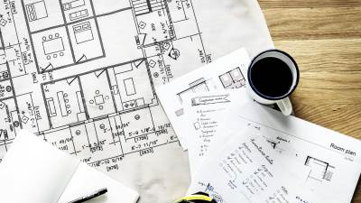

7. Project plan
The following QR is link to our project JIRA plan : LINK

Slide 57
Agenda
Background of the problem
Scientific Background
Comparison between related papers
Comparison between similar systems
Possible extensions to current solutions
Scope of work
Project plan
Tools and environment
Overview of environment and data
Experiments design
Result of experiments
Mobile implementation
Prototype implementation
Conclusion
Future work

Slide 58
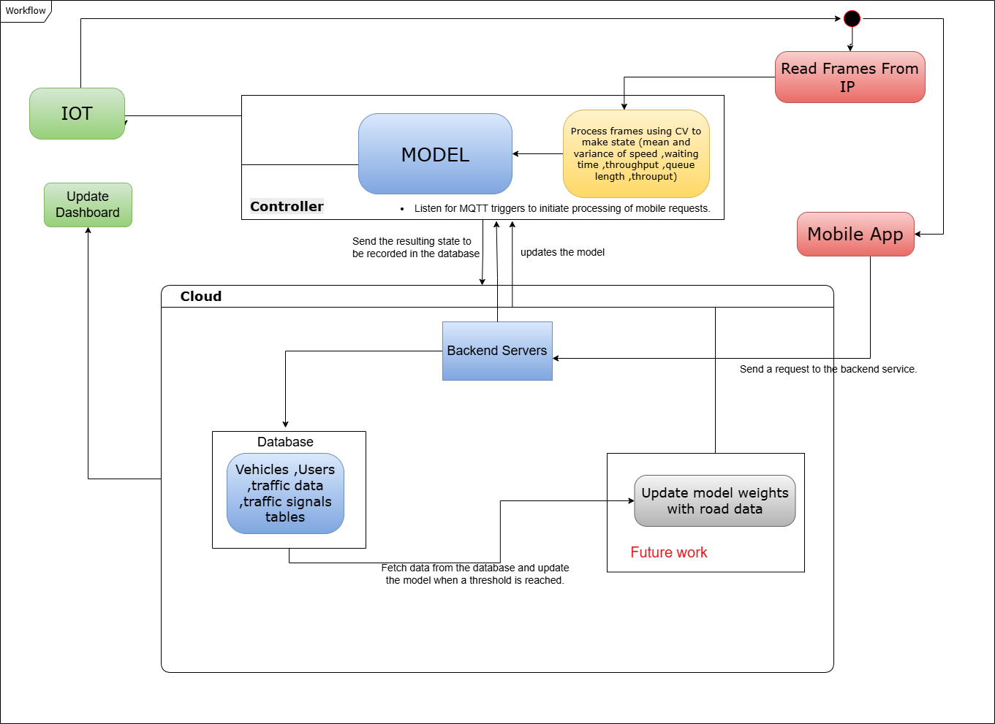
8. Tools and environment
Activity diagram

Slide 59
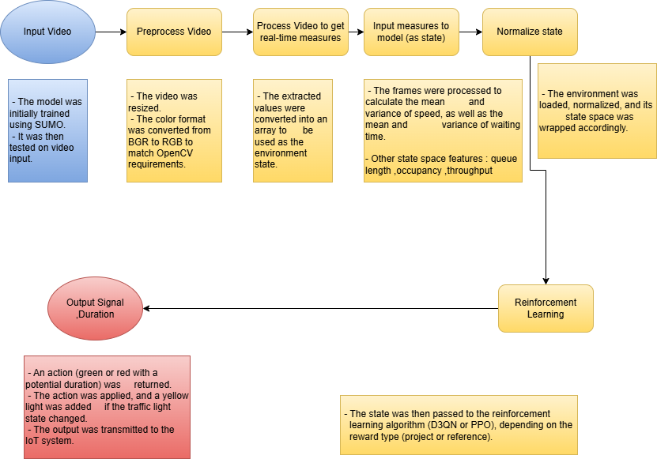
8. Tools and environment
Pipeline of traffic management processing model

Slide 60
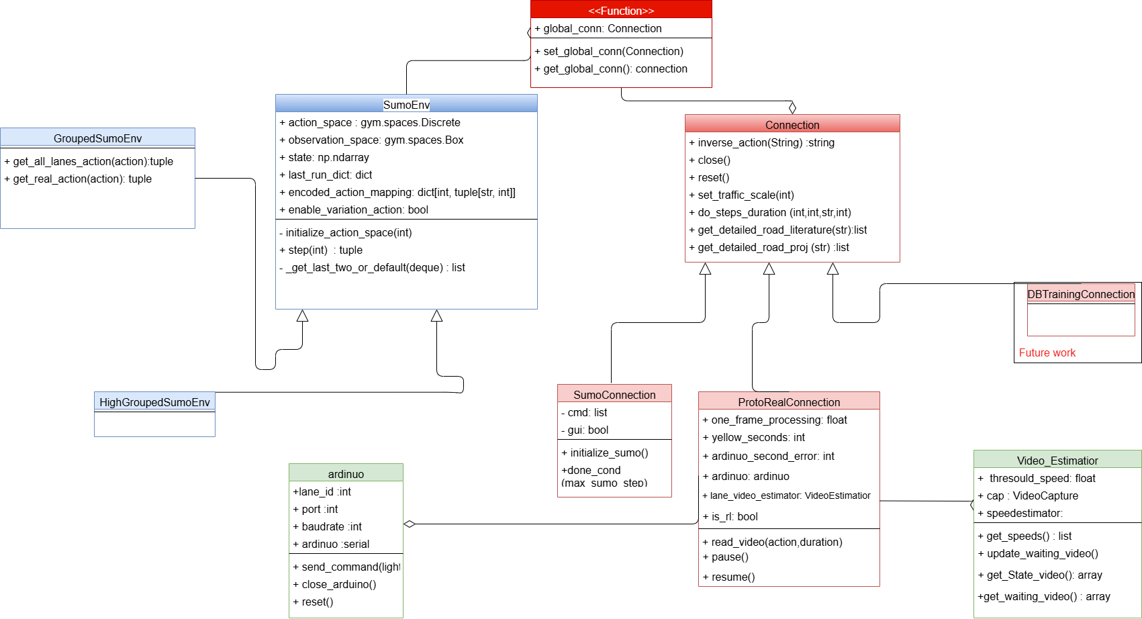
8. Tools and environment
Class Diagram

Slide 61
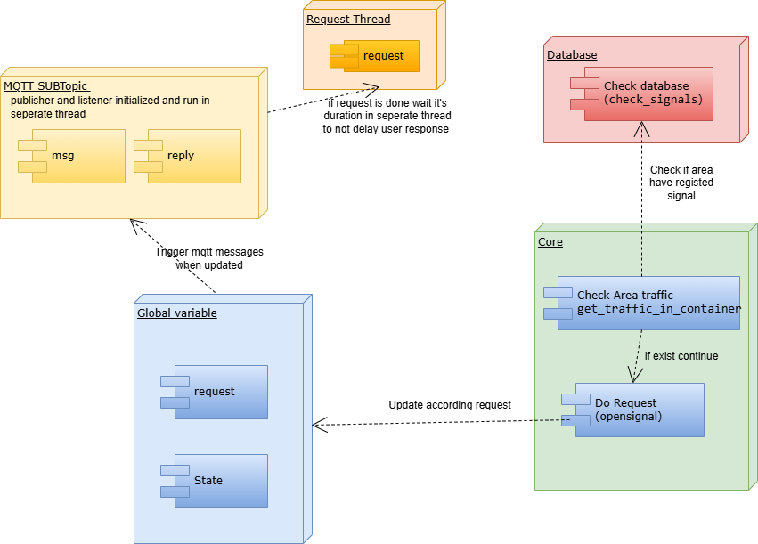
8. Tools and environment
Traffic Backend Component diagram

Slide 62
Tools and environment
Python
Simulation Framework: SUMO integrated with OpenAI Gym
Machine Learning Framework: TensorFlow (D3QN), StableBasline3 (PPO ,DQN at benchmark)
Result Analysis : Statsmodels (Anova), Seaborn ,Matplotlib
Mobile Development: Flutter
Backend : FastAPI
Hardware: Esp32
Video Processing: OpenCV ,Ultralytics ,fastapi
Deployment: Aiven, Huggingface

Slide 63
Objectives
1- Quick overview of the problem.
2- Explore Scientific Background.
3- Comparison of related papers and systems.
4- Overview of the need to extend current solutions.
5- Overview of tools and system design. 6- Overview of development and implementation. 7- Experimental design and results. 8- Demonstration of the implemented prototype. 9- Conclusion and future directions.

Slide 64
Agenda
Background of the problem
Scientific Background
Comparison between related papers
Comparison between similar systems
Possible extensions to current solutions
Scope of work
Project plan
Tools and environment
Overview of environment and data
Experiments design
Result of experiments
Mobile implementation
Prototype implementation
Conclusion
Future work

Slide 65
9. Overview of environment and data
Environment
State Space
Action Space
Reward
Data
Scale

Slide 66

9.1 Environment
Full SumoEnv
Assigns independent green/red signals to each lane.
Valid but introduces noise and is computationally expensive for intersections with many lanes.
May exceed Gym API capabilities used in this project.
Grouped SumoEnv
Groups lanes by direction.
Commonly used in related research [14] , [19, 2023].
High Grouped SumoEnv
Controls all lanes simultaneously.
Less optimal but matches the default traffic system design in Egypt (study context)

Slide 67

9.2 State Space
Avg_speed: This represents the average speed of all vehicles observed on the controlled lanes.
var_speed: This measures how much the vehicle speeds vary across the lanes.
avg_waiting_time: The average time vehicles spend waiting in the controlled lanes.
var_waiting_time: The variation in waiting times among vehicles in those lanes.
avg_throughput: The average number of vehicles that pass through a lane per time step.
avg_queue_length: The average number of vehicles stopped or waiting in queues across the lanes.
avg_occupancy: The average percentage of lane space occupied by vehicles, indicating lane usage.

Slide 68

9.3 Action Space
HighGroupedSumoEnv (HighGrouped)
A={(s,d)∣s∈{"r" * n,"g" * n},d∈D}
Where n is the number of lanes
D is the set of possible durations
g,r : traffic signal green, red

Slide 69

9.3 Action Space (Cont.)
GroupedSumoEnv
A={(s,d)∣s∈${\text{\{}\text{r}\text{,}\text{g}\text{\}}}^{4}$,d∈D}, D={d1,d2,...,dk}
D is the set of possible durations
g,r : traffic signal green, red

Slide 70
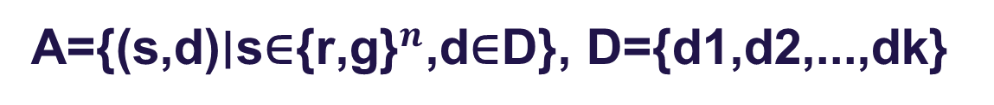
9.3 Action Space (Cont.)
Full
A={(s,d)∣s∈${\text{\{}\text{r}\text{,}\text{g}\text{\}}}^{n}$,d∈D}, D={d1,d2,...,dk}
Where n is the number of lanes
D is the set of possible durations
g,r : traffic signal green, red

Slide 71

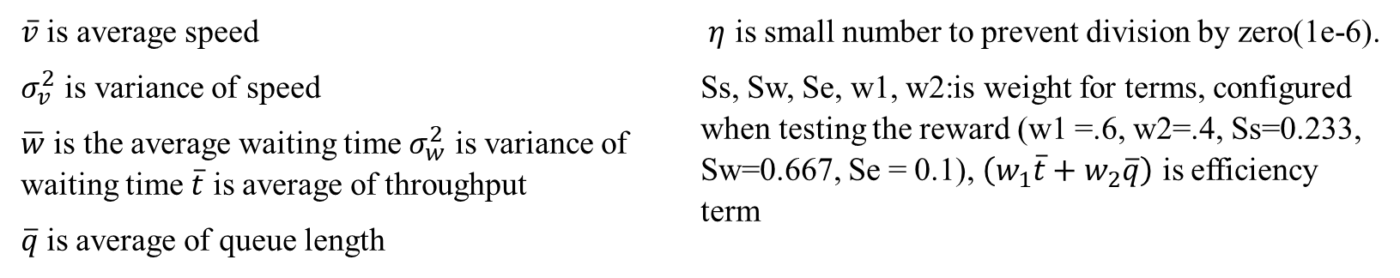
9.4 Reward
Proposed Reward
This is the primary reward function proposed and implemented in our work, used alongside comparative reward functions from the literature (detailed in the next slide).
$$R=Ss\left(\log\left(1+\frac{\overline{v}}{σ_{v}^{2}+η}\right)\right)−Sw\left(\frac{1}{1+\overline{w}+σ_{w}^{2}}\right)+Se\left(w_{1}\overline{t}−w_{2}\overline{q}\right)$$
$\overline{v}$ is average speed
$σ_{v}^{2}$ is variance of speed
$\overline{w}$ is the average waiting time $σ_{w}^{2}$ is variance of waiting time $\overline{t}$ is average of throughput
$\overline{q}$is average of queue length
$η$ is small number to prevent division by zero(1e-6).
Ss, Sw, Se, w1, w2:is weight for terms, configured when testing the reward (w1 =.6, w2=.4, Ss=0.233, Sw=0.667, Se = 0.1), $\left(w_{1}\overline{t}+w_{2}\overline{q}\right)$ is efficiency term

Slide 72

9.4 Reward(Cont.)
Literature Reward [1, 2024]
$$reward=\frac{1}{n_{wt}}\sum_{n=1}^{n_{wt}}{λ \left[1−{\left(\frac{{wt}_{n}}{T_{wt}}\right)}^{α}\right]}$$
nwt denotes the number of vehicles waiting at the intersection
Wtn represents the waiting time of vehicle n
Twt is the acceptable waiting time
λ and α are constants. Twt is set to 20, λ is set to 0.15, and α is set to 2.

Slide 73
9.4 Reward(Cont.)
Reference Project Reward [2, 2022]
This reward function, used in [2, 2022], achieved the best performance in the original study and is adopted here as a benchmark for comparison
R(s,a,a’) = (occupancy/haltingNumber) – hamming(a,a’) - emergencyStops
a,a’ are action ,last action accordingly

Slide 74

9.5 Data
Multiple areas were reconstructed to evaluate the model under diverse traffic conditions.
Data from a 48-hour SUMO random trip was preprocessed to simulate realistic traffic flow.

Slide 75
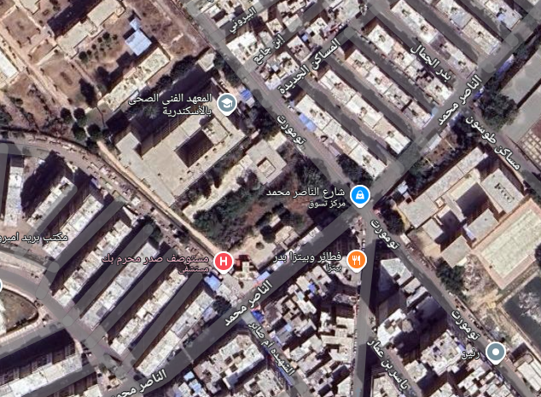
9.5 Data(Cont.)
Data 1 (Tomart)
A high-lane traffic light was randomly selected from the existing dataset to ensure robust model evaluation.
Sumo generated traffic light with 17 lane ,used for benchmarking

Slide 76
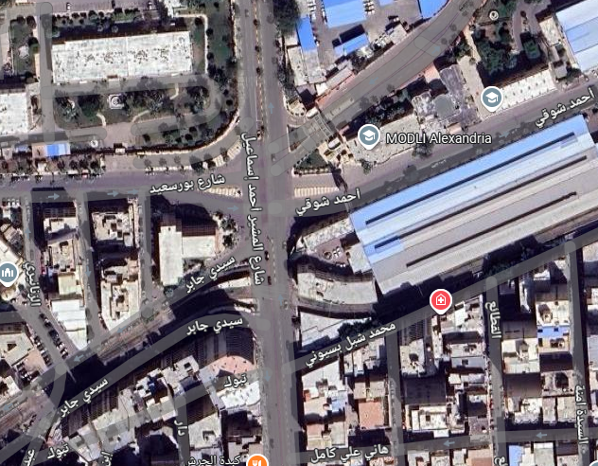
9.5 Data(Cont.)
Data 2 (Mosheer Ismail)
Traffic light layouts were approximated to real-world dimensions using geographic references from the Sidi Gaber and Mosher Ismail areas.

Slide 77
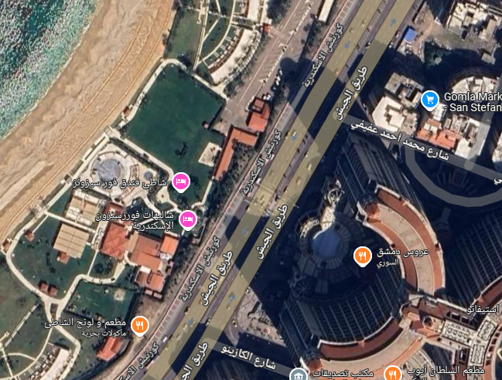
9.5 Data(Cont.)
Data 3 (San Stefano)
A separate real-world dataset was collected for the San Stefano area.

Slide 78
9.6 Scale
SUMO uses integer values to define traffic scale.
In this project, real-world data was used instead of default values.
Based on shown on next slide [22] Alexandria congestion levels:
Normal: ~14%
Crowded: ~38%
Selected scale values:
Normal = 1 (14% × 10)
Crowded = 3 (38% × 10)

Slide 79
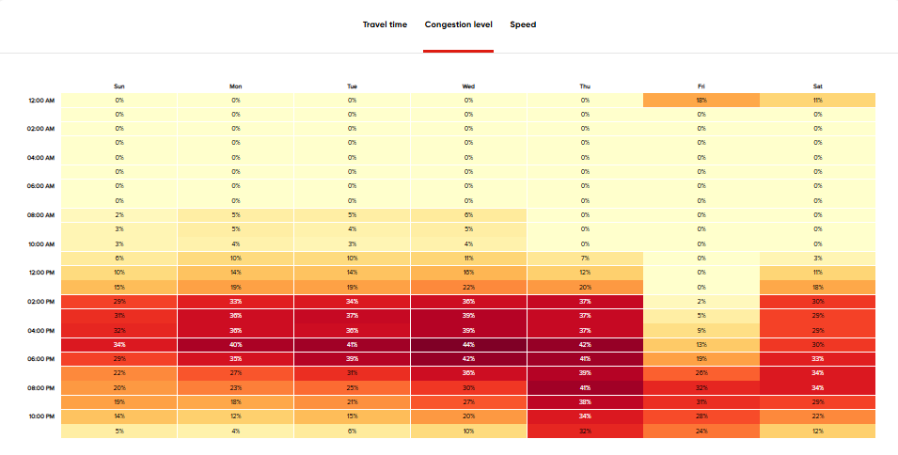
9.6 Scale(Cont.)

Slide 80
Objectives
1- Quick overview of the problem.
2- Explore Scientific Background.
3- Comparison of related papers and systems.
4- Overview of the need to extend current solutions.
5- Overview of tools and system design. 6- Overview of development and implementation. 7- Experimental design and results. 8- Demonstration of the implemented prototype. 9- Conclusion and future directions.

Slide 81
Agenda
Background of the problem
Scientific Background
Comparison between related papers
Comparison between similar systems
Possible extensions to current solutions
Scope of work
Project plan
Tools and environment
Overview of environment and data
Experiments design
Result of experiments
Mobile implementation
Prototype implementation
Conclusion
Future work

Slide 82
10 Experiment Design
Overview of Conducted Experiments
Experiment Design

Slide 83

10.1 Experiment Design
Parameter | Meaning | Real meaning | Range for experiment
Data | The dataset or environment used | Country-specific traffic data | Area 1 (Tomart)-Area2 (Mosheer Ismail)
Max sumo steps | Maximum number of simulation steps in SUMO | Represents the simulation time span—longer steps simulate longer real-world hours | (500-4000)
Traffic Scale | Traffic load intensity | Adjusts the number of vehicles generated in the simulation | Normal (.14) -Crowded (.38)

Slide 84
10.1 Experiment Design(Cont.)
Parameter | Range for experiment
Data | Area 1 (Tomart)-Area2 (Mosheer Ismail)
Action space | Full (SumoEnv)- GroupedSumoEnv HighGroupedSumoEnv
Reward | Reference Project(project)
Max sumo steps | (500-4000)
Run | Reference Project (Project) -Proposed
Seeds | 0,1,2
Traffic Scale | Normal (.14) -Crowded (.38)

Slide 85
10.1 Experiment Design(Cont.)
Parameter | Range for experiment
Area | Area2 (Mosheer Ismail) – Area 3 (San Stefano)
Reward | Literature - Proposed
Environment type | GroupedSumoEnv HighGroupedSumoEnv
Algorithm | D3QN -PPO
Episodes | 200-350-1000
Max sumo steps | 500-1500-4000
Traffic Scale | Normal (.14) - Crowding (.38)
Seeds | 0,1,2,3

Slide 86

10.2 Overview of Conducted Experiments
Re-ran initial test experiments from the reference project (22 runs).
Executed all SUMO test experiments (8 runs).
Ran experiments with the old configuration (without seed), which led to unreliable results (18 runs).
Performed full benchmark tests using the final configuration (48 runs).

Slide 87
10.2 Overview of Conducted Experiments(Cont.)
Episode Length Impact 2 datasets × 2 algorithms × 3-episode settings = 12 runs
SUMO Max Time Impact 2 datasets × 2 algorithms × 3-sumo time settings = 12 runs
Experiments Using Fixed Settings Episode = 350 SUMO Time = 2000s (≈33.3 minutes) → Total runs with these fixed settings = 163

Slide 88
10.2 Overview of Conducted Experiments(Cont.)
✅ Additional Analytical Focus
Algorithm Performance Analysis 2 datasets × 2 algorithms × 2 scales × 4 seeds
Reward Function Variation 2 datasets × 2 algorithms × 2 reward types
Traffic Signal Level Testing 2 datasets × 2 algorithms × 2 signal levels
🔢 Total Experiments Conducted: 259

Slide 89
Agenda
Background of the problem
Scientific Background
Comparison between related papers
Comparison between similar systems
Possible extensions to current solutions
Scope of work
Project plan
Tools and environment
Overview of environment and data
Experiments design
Result of experiments
Mobile implementation
Prototype implementation
Conclusion
Future work

Slide 90
11. Result of experiments
Results of Benechmark experiments
Results of Environment Experiments
Anova
Best Model Results

Slide 91

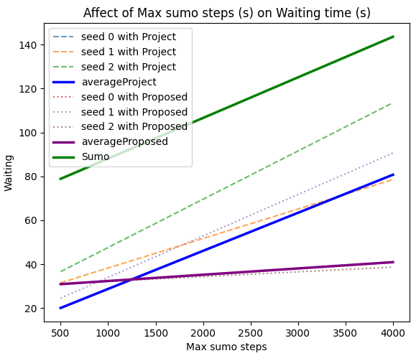
11.1 Results of Benechmark experiments
Waiting Time Analysis – Area 1 (Tomart) (Normal Scale)
Our proposed system demonstrates significantly lower waiting times, especially noticeable around 4000s (~1 hour).
Results show variation across different seeds

Slide 92
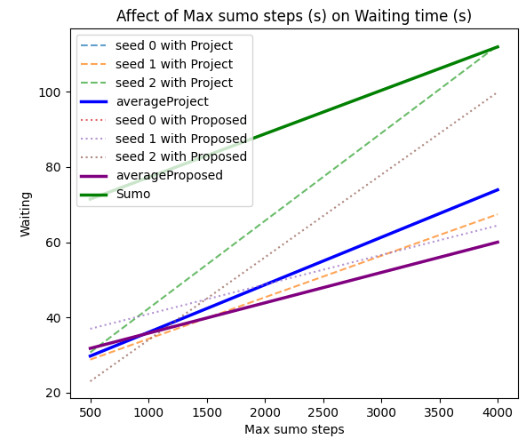
11.1 Results of Benechmark experiments(Cont.)
Waiting Time Analysis – Area 1 (Tomart) (Crowded Scale)
Our proposed system still demonstrates significantly lower waiting times,
Results show variation across different seeds.

Slide 93
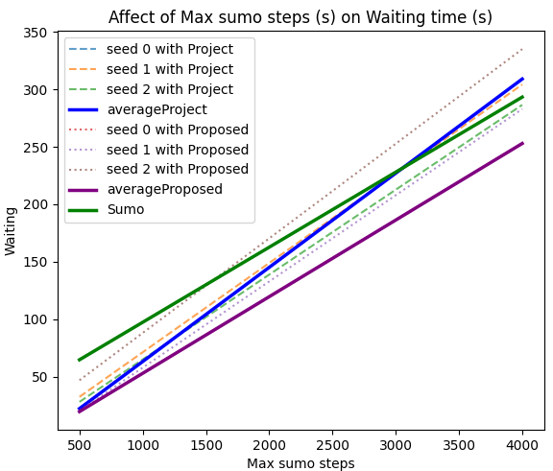
11.1 Results of Benechmark experiments(Cont.)
Waiting Time Analysis – Area 2 (Mosheer ismail) (Normal Scale)
The three approaches—basic SUMO, reference project, and our proposed system—show similar performance trends.
However, our proposed project consistently achieves the lowest waiting times, highlighting its effectiveness.

Slide 94
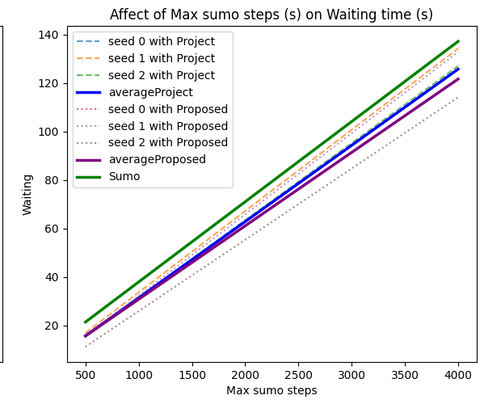
11.1 Results of Benechmark experiments(Cont.)
Waiting Time Analysis – Area 2 (Mosheer ismail) (Crowded Scale)
Same results is shown at crowded

Slide 95

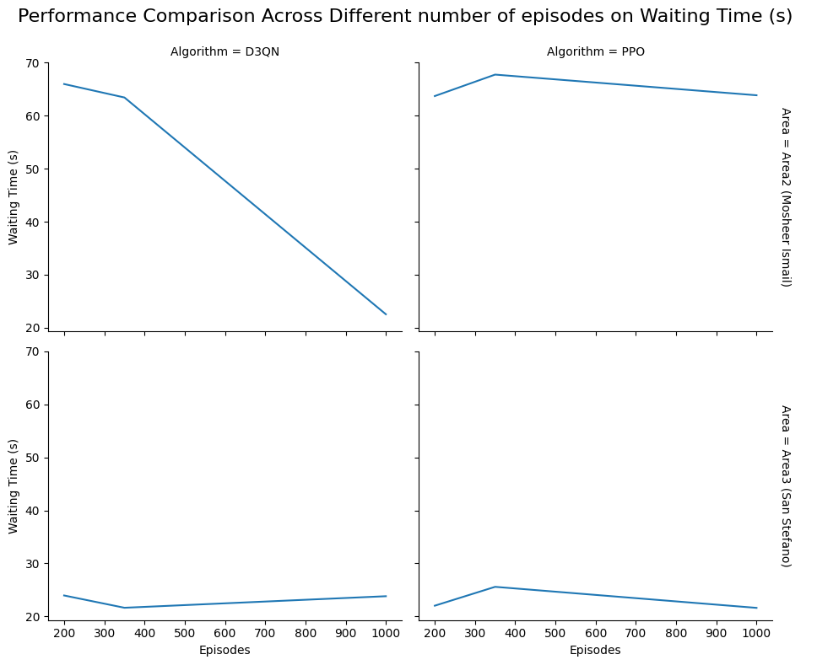
11.2 Results of Environment Experiments
📈 Episode Count Effect
Configuration: Proposed reward, traffic scale 0.38, 500 SUMO steps, high-grouped data. Note: Single-seed (0) used due to time constraints.
Result:
Increasing episodes improved: Waiting cars, Travel time, Average speed, Total reward (on Dataset 2 (Tomart) using D3QN)
Less affect on Area 3 (San Stefano)
Some noise observed due to single-seed limitation

Slide 96
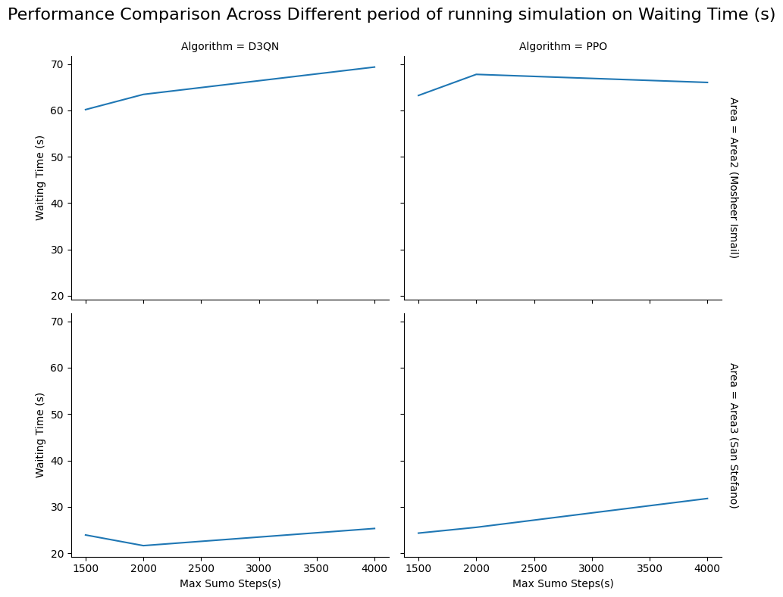
11.2 Results of Environment Experiments (Cont.)
⏳ SUMO Steps Effect
Configuration: Proposed reward, 1000 episodes, traffic scale 0.38, high-grouped data. Note: Single-seed (0) used. 🔍 Future Work: Multi-seed testing recommended to reduce variance.
Result:
Increasing SUMO steps led to higher waiting time and loss.
Despite this, the RL agent adapted and achieved better rewards.
Results showed high variance due to single-seed limitation.

Slide 97
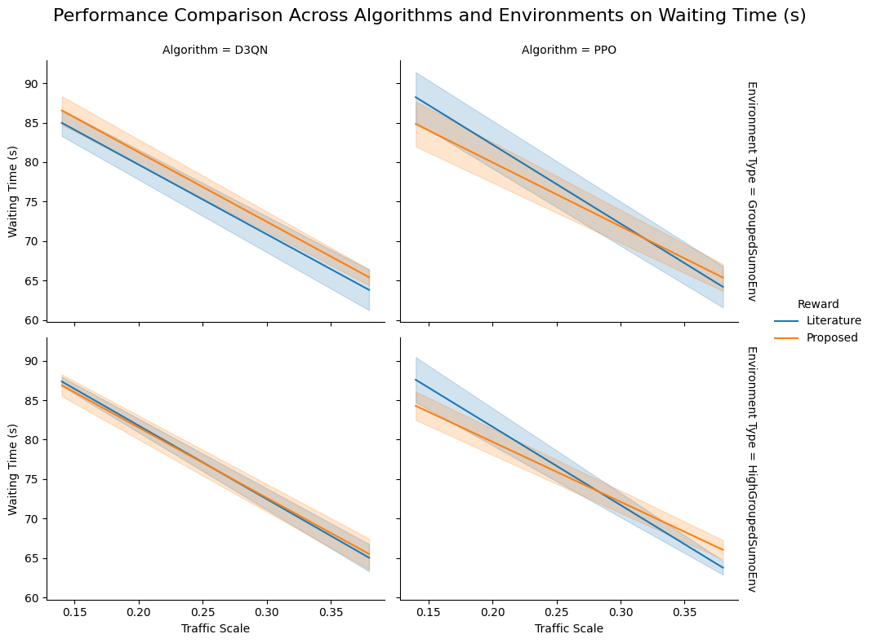
11.2 Results of Environment Experiments (Cont.)
Data 2

Slide 98
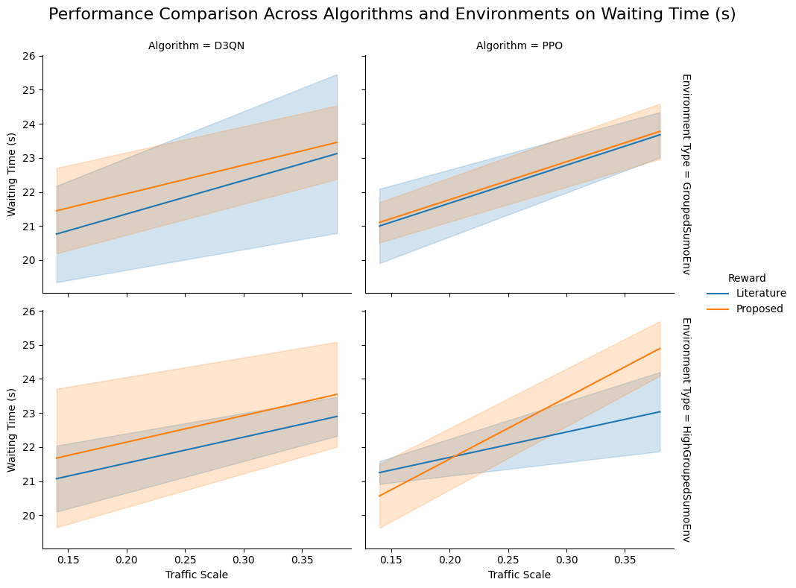
11.2 Results of Environment Experiments (Cont.)
Data 3

Slide 99
11.2 Results of Environment Experiments (Cont.)
🏆 Reward Function: Literature reward better in Dataset 3 (small difference); close results in Dataset 2.
🌱 Seed Variability: High variance between seeds[23]
📚 Learning Efficiency: Proposed reward enhanced learning (positive in Dataset 3, negative in Dataset 2 initially); improved with road parameters.
🤖 environmental experiments D3QN & other converged similarly; D3QN more stable with less noise.
🛤️ Grouping Effect: grouped showed minimal impact, possibly due to Egyptian road layout.

Slide 100
11.2 Results of Environment Experiments (Cont.)
🌍 Difference between Areas:
📊 Better performance in Dataset 3 (San Stefano) with non-negative rewards, likely due to road infrastructure and car flow.
🚗 Dataset 2 (Mosheer Ismail) harder due to narrower lanes & lower speeds (~7 m/s in AlST vs. ~18 m/s in LuST).
🔍 Future: Address geographical simulation challenges for realistic traffic modeling.

Slide 101

Area | Reward | Traffic Scale | Algorithm | Reward of Last Episode | Waiting Time (s) | Speed (m/s) | Depart Delay (s) | Time Loss (s) | Waiting Car
Area3 (San Stefano) | Literature | 0.14 | PPO | 0.211171 | 0.673872 | 0.252849 | 0.624318 | 0.631029 | 0.839421
Area2 (Mosheer Ismail) | Literature | 0.14 | PPO | 0.49756 | 0.771623 | 0.214706 | 0.823133 | 0.86741 | 0.643226
Area3 (San Stefano) | Proposed | 0.14 | PPO | 0.919798 | 0.37047 | 0.0773891 | 0.22451 | 0.160713 | 0.0398628
Area2 (Mosheer Ismail) | Proposed | 0.14 | PPO | 0.48622 | 0.753739 | 0.363079 | 0.451698 | 0.66866 | 0.965445
Area3 (San Stefano) | Literature | 0.38 | PPO | 0.321063 | 0.376744 | 0.789099 | 0.333174 | 0.891971 | 0.323796
Area2 (Mosheer Ismail) | Literature | 0.38 | PPO | 0.0501503 | 0.766994 | 0.319131 | 0.48455 | 0.930467 | 0.95313
Area3 (San Stefano) | Proposed | 0.38 | PPO | 0.464083 | 0.0984053 | 0.0444354 | 0.215673 | 0.332536 | 0.625921
Area2 (Mosheer Ismail) | Proposed | 0.38 | PPO | 0.356003 | 0.546678 | 0.786843 | 0.557952 | 0.675678 | 0.765449
Area3 (San Stefano) | Literature | 0.14 | D3QN | 0.688833 | 0.743306 | 0.494866 | 0.114162 | 0.855852 | 0.192344
Area2 (Mosheer Ismail) | Literature | 0.14 | D3QN | 0.301997 | 0.0358339 | 0.143797 | 0.516375 | 0.00580131 | 0.00456948
Area3 (San Stefano) | Proposed | 0.14 | D3QN | 0.00101296 | 0.853829 | 0.136805 | 0.805795 | 0.968167 | 0.413561
Area2 (Mosheer Ismail) | Proposed | 0.14 | D3QN | 0.749427 | 0.77916 | 0.136595 | 0.426554 | 0.946116 | 0.806054
Area3 (San Stefano) | Literature | 0.38 | D3QN | 0.732422 | 0.858222 | 0.625868 | 0.420143 | 0.517794 | 0.409174
Area2 (Mosheer Ismail) | Literature | 0.38 | D3QN | 0.134828 | 0.460697 | 0.214563 | 0.53454 | 0.585142 | 0.431086
Area3 (San Stefano) | Proposed | 0.38 | D3QN | 0.442762 | 0.924835 | 0.714651 | 0.543875 | 0.871118 | 0.562764
Area2 (Mosheer Ismail) | Proposed | 0.38 | D3QN | 0.581691 | 0.933766 | 0.152576 | 0.578887 | 0.992819 | 0.877516
11.3 Anova
📚 To further study the effect of environment grouping on results, we conducted an ANOVA test [24].
🔍 ANOVA Analysis: Evaluated whether highly grouped environments lead to better performance.
✅ Significance Level: Set at 97% to ensure strong statistical confidence.
📉 Results: Most comparisons revealed no significant improvement in high-grouped environments.
🛣️ Possible Reason: The single-direction road design likely limited the benefits of environment grouping.

Slide 102

11.4 Best Model Results
📋 Overall Results:
⏱️ Waiting time excellent (~20-90s for 30 mins compared to static light ), max possible speed achieved with short timeLoss.
🚦 High waiting cars with short waiting time, indicating fair distribution.
⏳ Larger depart delay (1.5M-13.3M) needs further learning
Exact metrics got from best experiments is shown on next slides

Slide 103
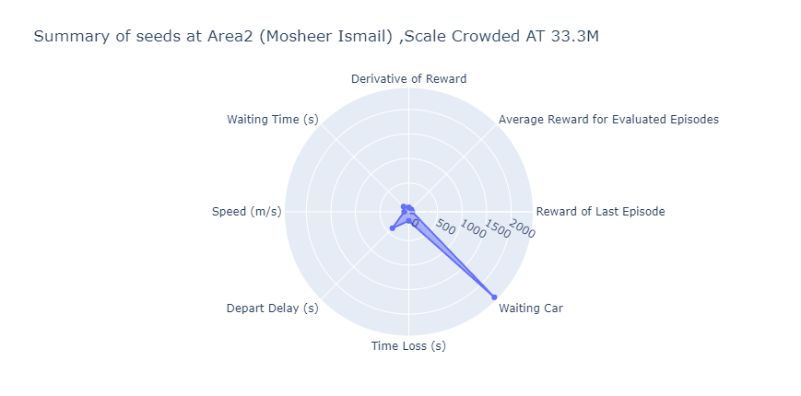
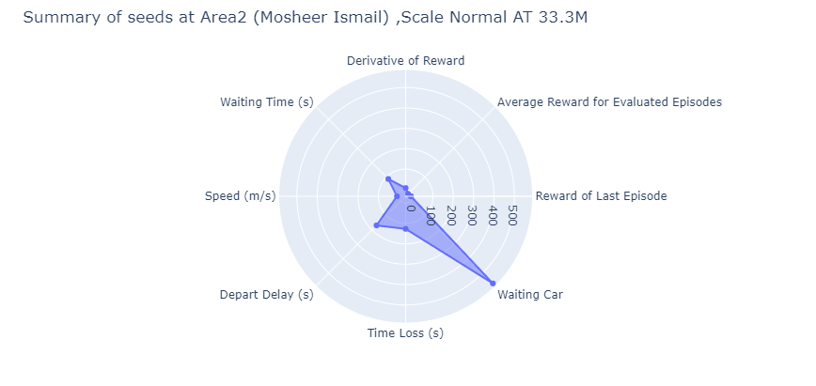
11.4 Best Model Results(Cont.)
link
link

Slide 104
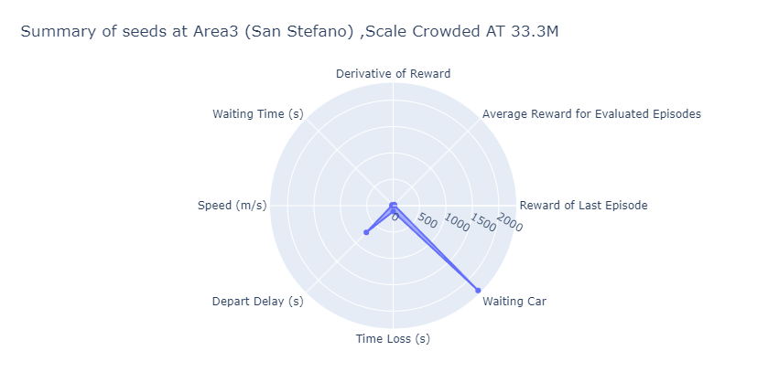
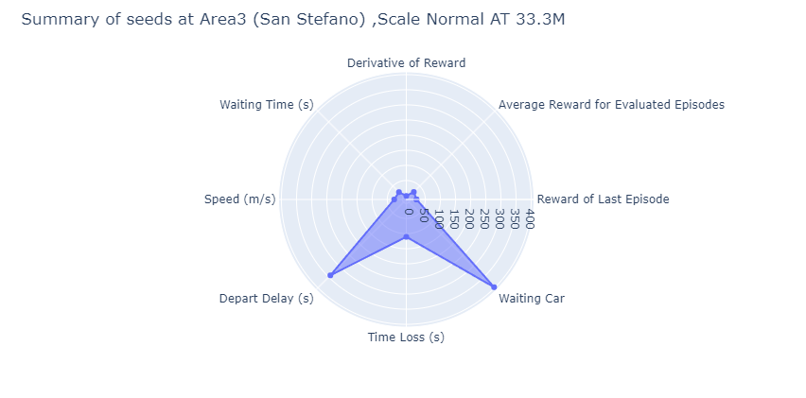
11.4 Best Model Results(Cont.)
link
link

Slide 105
Objectives
1- Quick overview of the problem.
2- Explore Scientific Background.
3- Comparison of related papers and systems.
4- Overview of the need to extend current solutions.
5- Overview of tools and system design. 6- Overview of development and implementation. 7- Experimental design and results. 8- Demonstration of the implemented prototype. 9- Conclusion and future directions.

Slide 106
Agenda
Background of the problem
Scientific Background
Comparison between related papers
Comparison between similar systems
Possible extensions to current solutions
Scope of work
Project plan
Tools and environment
Overview of environment and data
Experiments design
Result of experiments
Mobile implementation
Prototype implementation
Conclusion
Future work

Slide 107
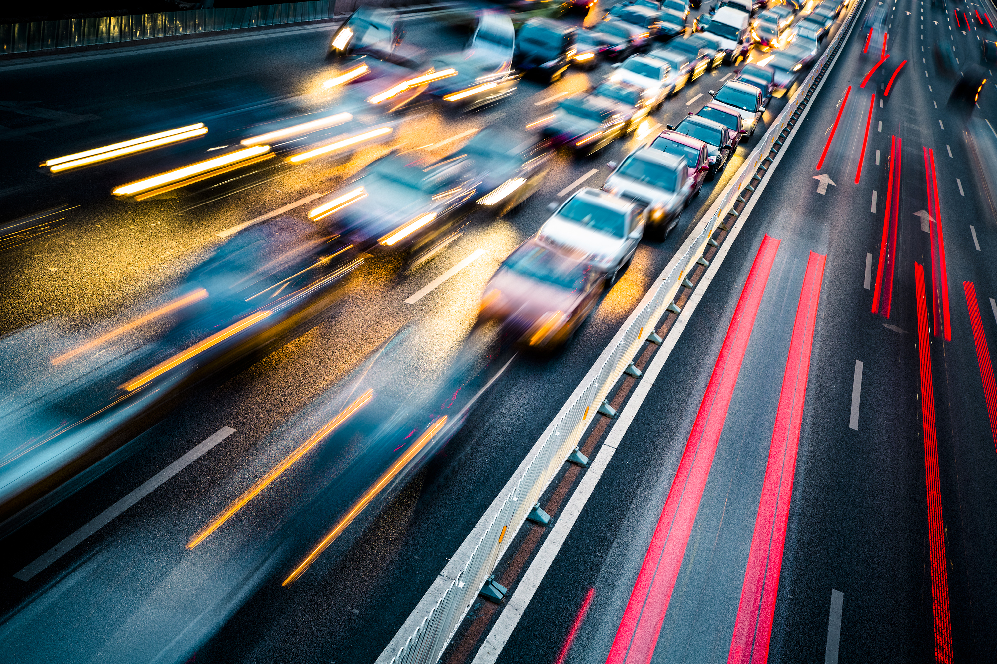

12. Mobile implementation(Cont.)
The following QR is link DEMO: LINK

Slide 108
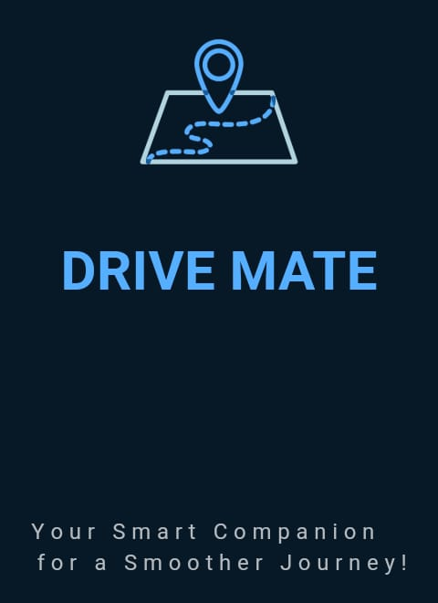
12. Mobile implementation
🚗 DRIVE MATE – Smart Traffic Management App
Purpose: Enhance emergency response and road safety through intelligent traffic control.
Emergency Vehicle Assistance:
Opens traffic signals for emergency vehicles to ensure smooth passage.
Accident Management:
Allows users to report road-blocking accidents.
Automatically closes the traffic signal at the affected location.

Slide 109
12. Mobile implementation(Cont.)
🚦 How the DRIVE MATE App Works
User Login
Secure access to the app through user authentication.
Request Setup
User selects desired route (From → To)
Specifies duration, expected delay, and request type:
Emergency (e.g., ambulance)
Accident (e.g., road blockage)
Route Calculation
System calculates the shortest path for the selected route.
Sends the request details to the backend.

Slide 110
12. Mobile implementation(Cont.)
🚦 How the DRIVE MATE App Works(Cont.)
4. Backend Processing
Evaluates real-time traffic conditions and queue lengths.
Searches for traffic signals in the selected area that are registered and have our system implemented.
Approves or rejects the request based on dynamic logic.
Executes action: Opens signal for emergencies or closes signal for accidents.

Slide 111
12. Mobile implementation(Cont.)
🔐 Login Mechanism
Access is restricted to registered users only to ensure security and control.
Users log in using their National ID, Vehicle Number, and Password.
User accounts are created exclusively by system administrators — self-registration is not allowed.
New admins can only be added by existing administrators, maintaining strict access control.

Slide 112
12. Mobile implementation(Cont.)
Connectivity Solution 🌐:
Addresses unreliable internet at signal locations using a TCP/IP-like protocol with message sequence: CHK → ACK → DONE QL? → QL.... → EMR/ACC ...duration…. .

Slide 113
Agenda
Background of the problem
Scientific Background
Comparison between related papers
Comparison between similar systems
Possible extensions to current solutions
Scope of work
Project plan
Tools and environment
Overview of environment and data
Experiments design
Result of experiments
Mobile implementation
Prototype implementation
Conclusion
Future work

Slide 114

13. Prototype implementation(Cont.)
The following QR is link DEMO: LINK

Slide 115
13. Prototype implementation
Video Processing
YOLOv11 Implementation 🖼️: Utilizes YOLOv11 to process images, extract speed, and manage waiting periods.
Video Processing 🎥:
Processes IP video frames via FastAPI, handling looping random videos.
Captures one frame, processes it, then proceeds to the next frame.
Control Mechanisms ⏯️: Includes dummy methods for stopping and pausing video, simulating signal application.

Slide 116
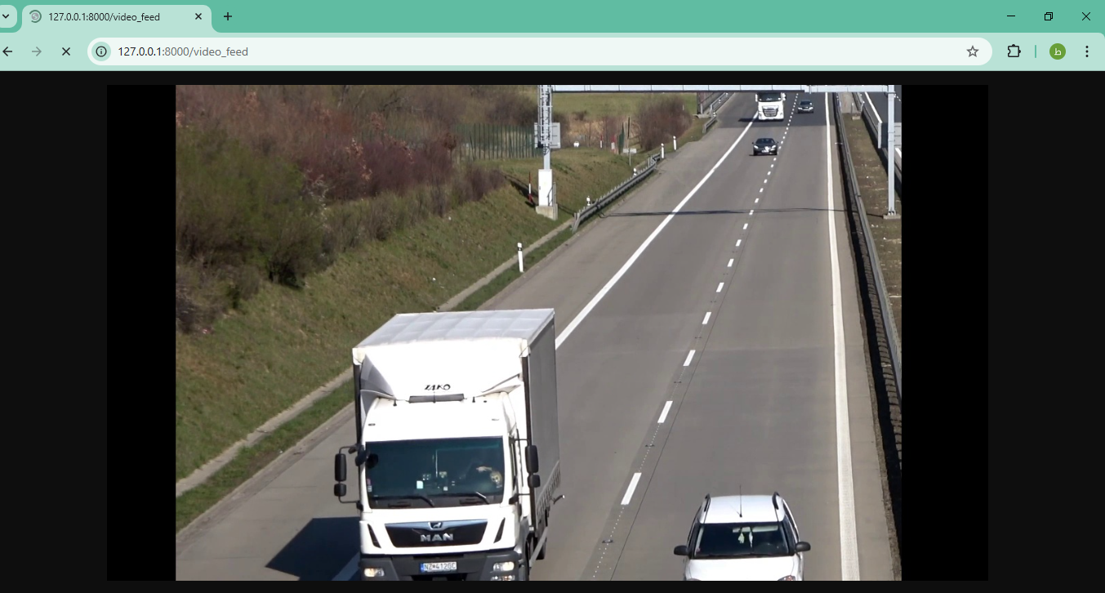
13. Prototype implementation(Cont.)
Video Processing(Cont.)
It then Generates state data and passes it to the model for predicting action.
.

Slide 117
13. Prototype implementation(Cont.)
⚙️ Output Action
The system sends the signal status and duration to an Arduino device.
Communication is done via serial interface, enabling real-time signal control.
Signal Transmission Errors 📡:
Errors in signals sent to Arduino are mitigated by subtracting from the video duration.

Slide 118
13. Prototype implementation(Cont.)
Dashboard 🕒
Tool Development 🛠️:
Built a tool for real-time observation of system interactions.
Benefits 📊:
Enabled easier debugging and performance evaluation.
Impact ✅:
Enhanced system reliability and efficiency through real-time monitoring and analysis.

Slide 119
Objectives
1- Quick overview of the problem.
2- Explore Scientific Background.
3- Comparison of related papers and systems.
4- Overview of the need to extend current solutions.
5- Overview of tools and system design. 6- Overview of development and implementation. 7- Experimental design and results. 8- Demonstration of the implemented prototype. 9- Conclusion and future directions.

Slide 120
Agenda
Background of the problem
Scientific Background
Comparison between related papers
Comparison between similar systems
Possible extensions to current solutions
Scope of work
Project plan
Tools and environment
Overview of environment and data
Experiments design
Result of experiments
Mobile implementation
Prototype implementation
Conclusion
Future work

Slide 121
14. Conclusion
Urban traffic management is recognized as a critical issue affecting daily life and energy consumption. Traditional systems are often challenged by inefficient energy use and suboptimal traffic flow. In this work, a system was designed using reinforcement learning to optimize traffic, with awareness of emergencies and accidents. Low waiting times, high speeds, fairness, reliability, and real-time performance were achieved.

Slide 122
Agenda
Background of the problem
Scientific Background
Comparison between related papers
Comparison between similar systems
Possible extensions to current solutions
Scope of work
Project plan
Tools and environment
Overview of environment and data
Experiments design
Result of experiments
Mobile implementation
Prototype implementation
Conclusion
Future work

Slide 123
15. Future work
From slide 5. Possible extensions to current solutions
The model accuracy will be improved, and a comparison will be made with the results from the official paper.
Further analysis will be conducted at data2 to investigate the causes of low training performance.
Training will be conducted on episodes initialized with different random seeds and on more experiments to improve robustness and generalization.
The process of identifying and selecting the signal that aligns with the user’s direction will be further investigated.

Slide 124
15. Future work(Cont.)
Signal duration and delay adjustments will be automated to reduce manual configuration and improve responsiveness.
User experience in the mobile app will be improved by notifying users, helping them select roads, predicting better routes, and gathering feedback.
An appropriate license will be added to the project to define usage and distribution terms clearly.
Real-life performance will be used in training.
Online reinforcement learning (RL) will be implemented and optimized with new data.
The model will be optimized for deployment on a Raspberry Pi, and data collection will be optimized using GPS and inductive loops.

Slide 125
15. Future work(Cont.)
Scaling to dependent multi-agent systems will be implemented.
Consideration will be given to state, temporal, spatial, and nearby information as a new trend.
Cybersecurity measures will be considered.
Control will be established for Egypt’s GPS to identify traffic violators.

Slide 126
THANK YOU

Slide 127
References
[1, 2024] M. M. Dhanvijay and S. C. Patil, "Energy efficient deep reinforcement learning approach to control the traffic flow in IoT networks for smart city," J. Ambient Intell. Human Comput., vol. 15, pp. 3945–3961, Dec. 2024, doi: 10.1007/s12652-024-04869-w.
[2, 2022] K. Sabra, M. Moustafa, et al., "Intelligent Traffic Analysis," B. Sc. Degree, Graduation Project, Computer and Systems Engineering Department, Faculty of Engineering, Alexandria University, 2023.
[3,2024] Ahram Online, “Egypt constructed 945 bridges and tunnels in last 10 years: Ministry,” Ahram English, Jul. 2024. [Online]. Available: https://english.ahram.org.eg/NewsContent/1/1235/526427/Egypt/Urban--Transport/Egypt-constructed--bridges-and-tunnels-in-last--ye.aspx
[4] TWI, "What is simulation?," TWI Global. [Online]. Available: https://www.twi-global.com/technical-knowledge/faqs/faq-what-is-simulation#WhatDoesitMean. [Accessed: Dec. 1, 2024].
[5] DLR, "SUMO Tutorials," SUMO Documentation, Available: https://sumo.dlr.de/docs/Tutorials/, Accessed: Nov. 18, 2024

Slide 128
References
[6] Hugging Face, "Clipped Surrogate Objective," Deep Reinforcement Learning Course, accessed Dec. 20, 2024. [Online]. Available: https://huggingface.co/learn/deep-rl-course/unit8/clipped-surrogate-objective
[7, 2019] L. N. Alegre, "SUMO-RL," GitHub repository, 2019. [Online]. Available: https://github.com/LucasAlegre/sumo-rl. [Accessed: Dec. 7, 2024].
[8, 2022] L. Wang, Z. Ma, C. Dong, and H. Wang, "Human‐centric multimodal deep (HMD) traffic signal control," IET Intelligent Transport Systems, vol. 17, no. 4, pp. 744-753, 2023.
[9, 2024] C. Wu, I. Kim, and Z. Ma, "Deep Reinforcement Learning Based Traffic Signal Control: A Comparative Analysis," in Proc. 14th Int. Conf. Ambient Syst., Netw. Technol. (ANT), Leuven, Belgium, Mar. 15-17, 2023. Available: https://www.sciencedirect.com/proceedings/browse.
[10] S. Forsyth and J. Ponce, Computer Vision: A Modern Approach, 2nd ed. Upper Saddle River, NJ, USA: Prentice Hall, 2012.
[11] R. Kundu, “YOLO: Algorithm for Object Detection Explained [+Examples],” V7. https://www.v7labs.com/blog/yolo-object-detection

Slide 129
References
[12] C. Wu, I. Kim, and Z. Ma, "Deep Reinforcement Learning Based Traffic Signal Control: A Comparative Analysis," in Proc. 14th Int. Conf. Ambient Syst., Netw. Technol. (ANT), Leuven, Belgium, Mar. 15-17, 2023. Available: https://www.sciencedirect.com/proceedings/browse.
[13] M. Al-Turki, M. T. Kashifi, and N. T. Ratrout, "Traffic signal optimization framework using interpretable machine learning technique under heterogeneous-autonomy traffic environment," Neural Computing and Applications, vol. 36, no. 22, pp. 13761–13781, Aug. 2024, doi: 10.1007/s00521-024-09694-y.
[14] Q. U. Jamil et al., "Urban traffic signal control optimization through Deep Q Learning and double Deep Q Learning: a novel approach for efficient traffic management," pp. 1-24, 2024.
[15] "Traffic Management Software Development," Intellias. https://intellias.com/traffic-management-softwaredevelopment/ (accessed Dec. 25, 2022
[16] Advanced traffic management system software TOPXVIEW | Telegra (telegra-europe.com)

Slide 130
References
[17] Iteris, "A leader in smart mobility," [Online]. Available: https://www.iteris.com/. [Accessed: Nov. 19, 2024].
[18] Kapsch TrafficCom, "Specializes in intelligent transportation systems, offering solutions for tolling, traffic management, and vehicle-to-infrastructure communication," [Online]. Available: https://www.kapsch.net/de. [Accessed: Nov. 19, 2024].
[19, 2023] T. Hu, Z. Hu, Z. Lu, and X. Wen, "Dynamic traffic signal control using mean field multi-agent reinforcement learning in large scale road-networks," IET Intelligent Transport Systems, 2023
[20, 2024] Hugging Face, "Variance Problem," Deep Reinforcement Learning Course, accessed Dec. 20, 2024. [Online]. Available: https://huggingface.co/learn/deep-rl-course/unit6/variance-problem
[21, 2021] M. Wang, L. Wu, J. Li, and L. He, "Traffic signal control with reinforcement learning based on region-aware cooperative strategy," IEEE Transactions on Intelligent Transportation Systems, vol. 23, no. 7, pp. 6774–6785, 2021.
[22] TomTom, "Alexandria Traffic," TomTom Traffic Index, accessed Jun. 12, 2024. [Online]. Available: https://www.tomtom.com/traffic-index/alexandria-traffic/

Slide 131
References
[23] “Reinforcement Learning Tips and Tricks — Stable Baselines 2.10.3a0 documentation.” https://stable-baselines.readthedocs.io/en/master/guide/rl_tips.html
[24] S. Seabold and J. Perktold, "Statsmodels: Econometric and statistical modeling with Python," in Proc. 9th Python in Science Conf. (SciPy), Austin, TX, USA, 2010, pp. 92–96.

